Slide 1


Blended intensive programme – Introduction to OpenSim
Basilio Goncalves & Hans Kainz

Slide 2

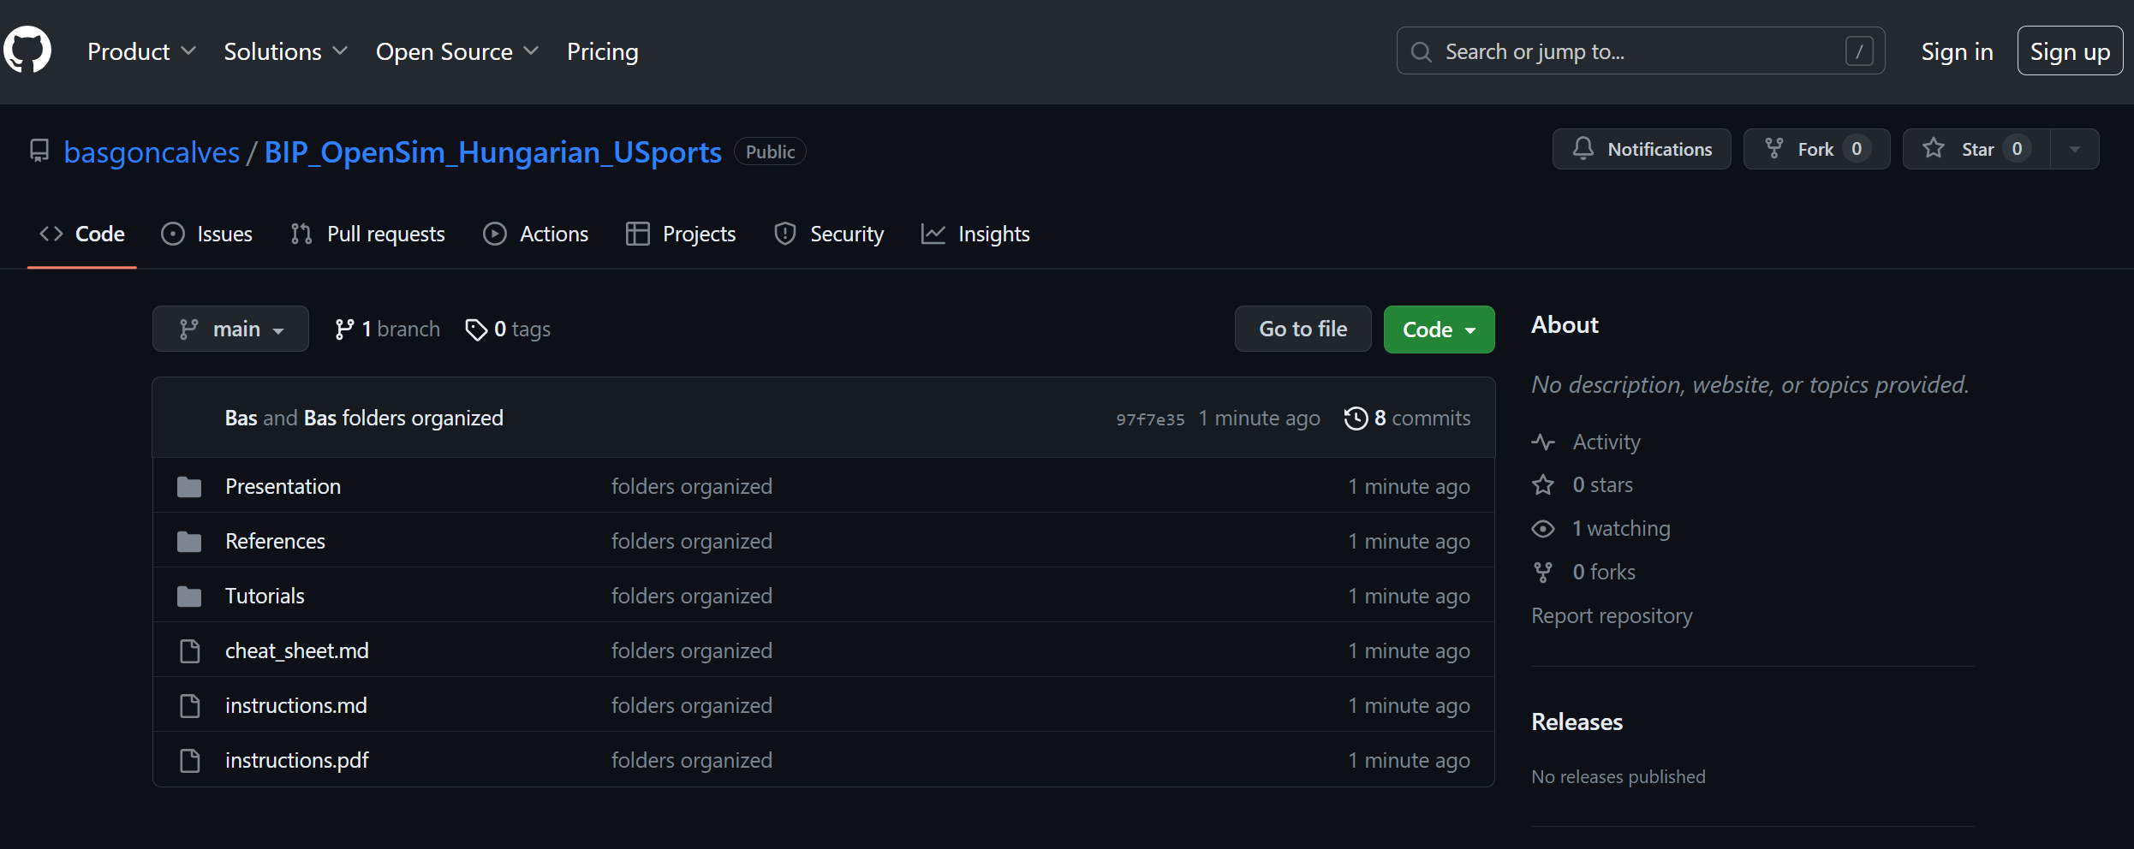
https://github.com/basgoncalves/BIP_OpenSim_Hungarian_USports
Notes:
https://github.com/basgoncalves/BIP_OpenSim_Hungarian_USports

Slide 3
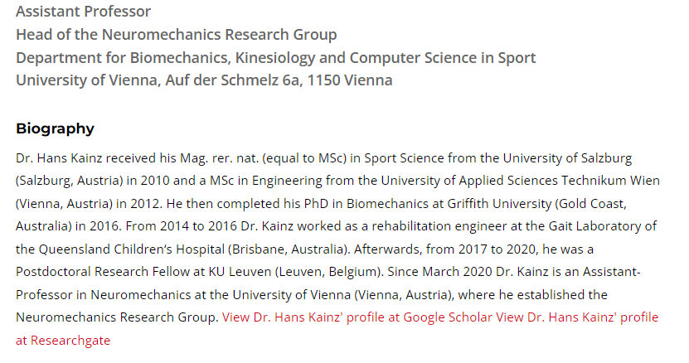
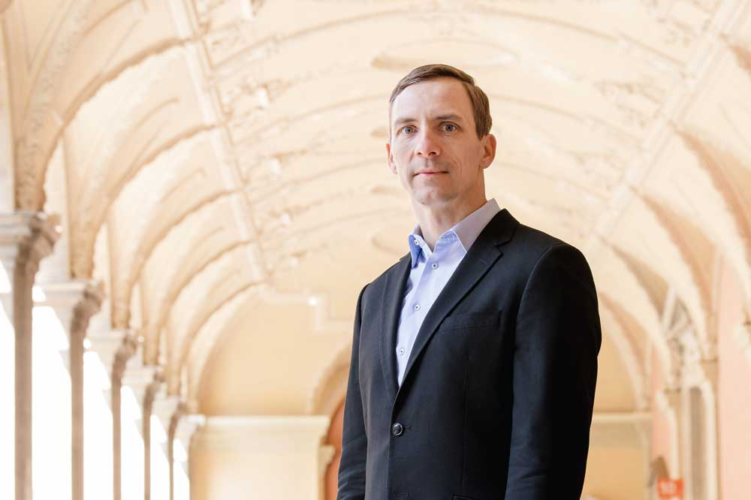
Hans
Who are we?

Slide 4
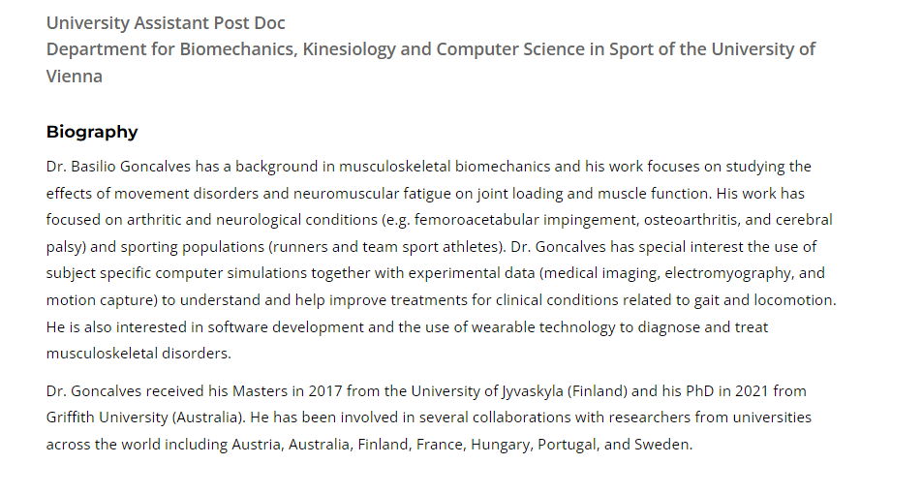
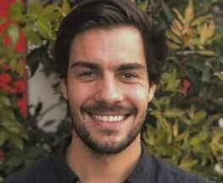
Bas
Who are we?

Slide 5
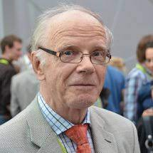
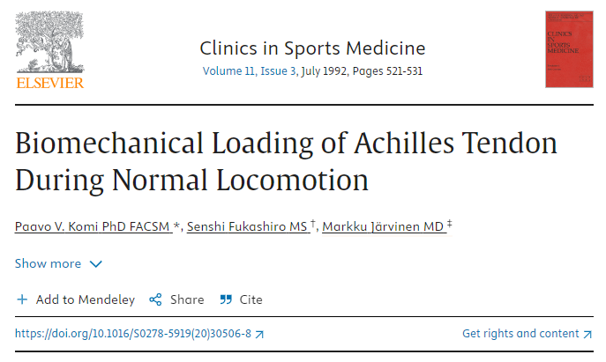
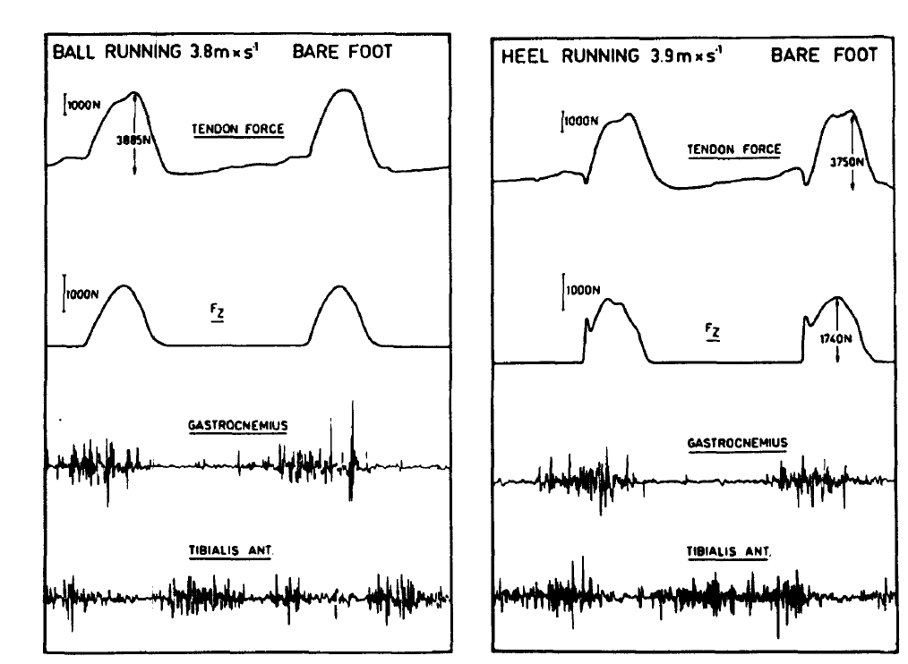
Why do we care?
Notes:
https://www.sciencedirect.com/science/article/abs/pii/S0278591920305068

Slide 6
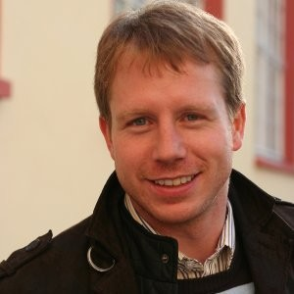
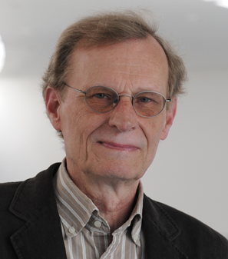
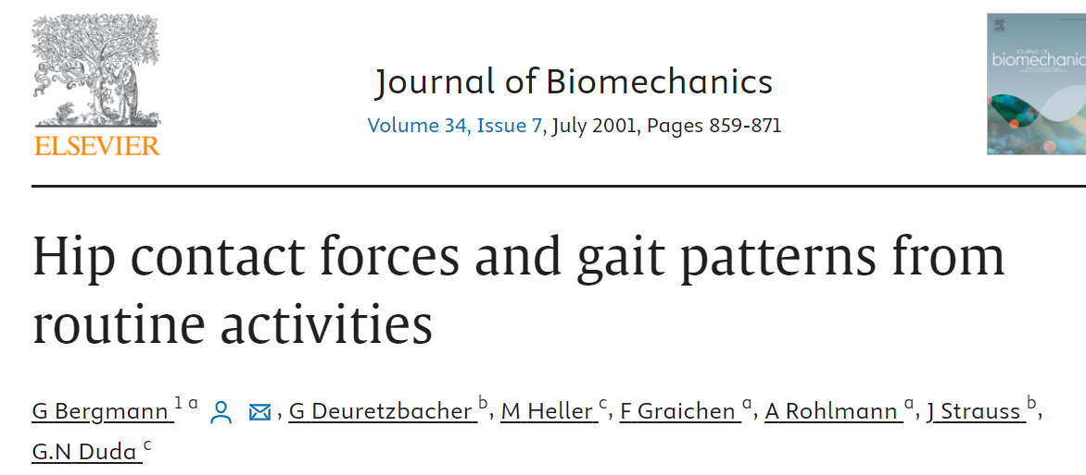
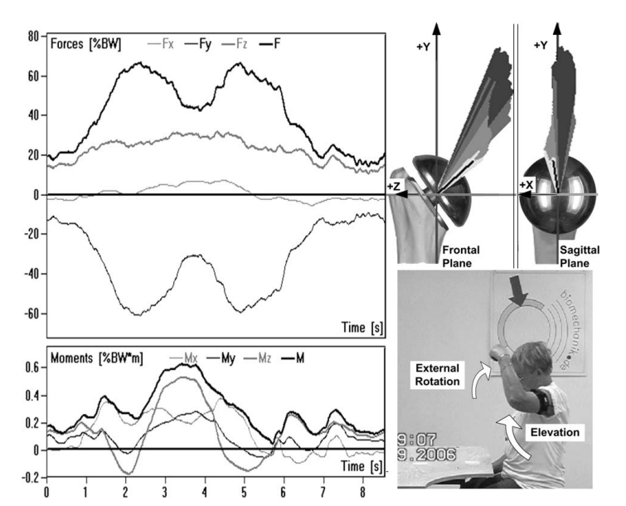
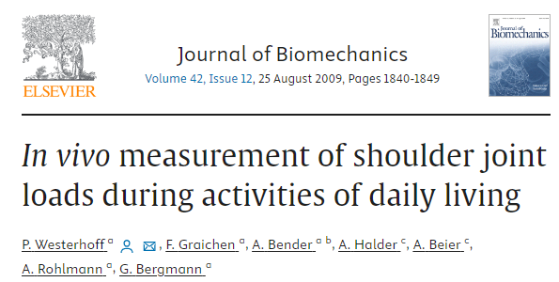
Why do we care?
Notes:
https://www.sciencedirect.com/science/article/abs/pii/S0021929009003169?via%3Dihub
https://www.sciencedirect.com/science/article/abs/pii/S0021929001000409?via%3Dihub

Slide 7
Main problems with in-vivo measurements
Why do we care?
Invasive
Cannot measure more than one muscle group
May alter individuals movement patters

Slide 8


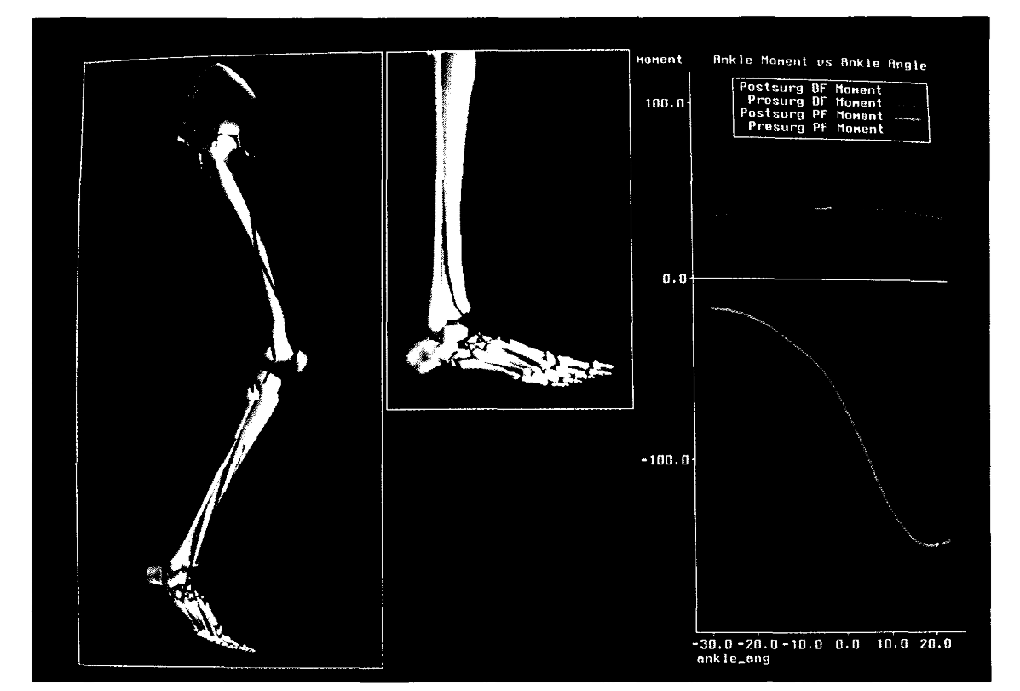
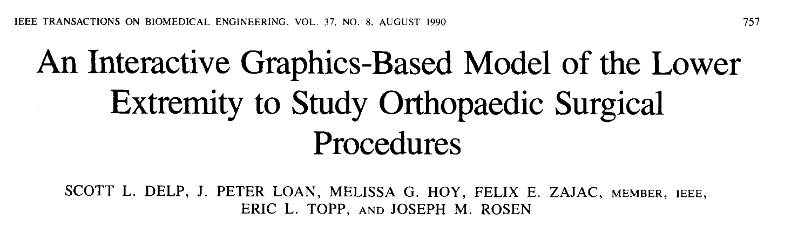
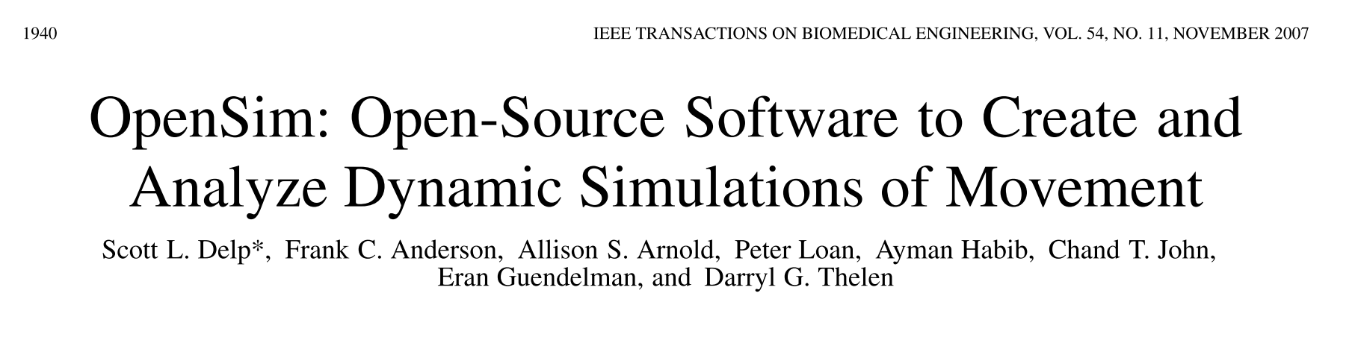

Slide 9
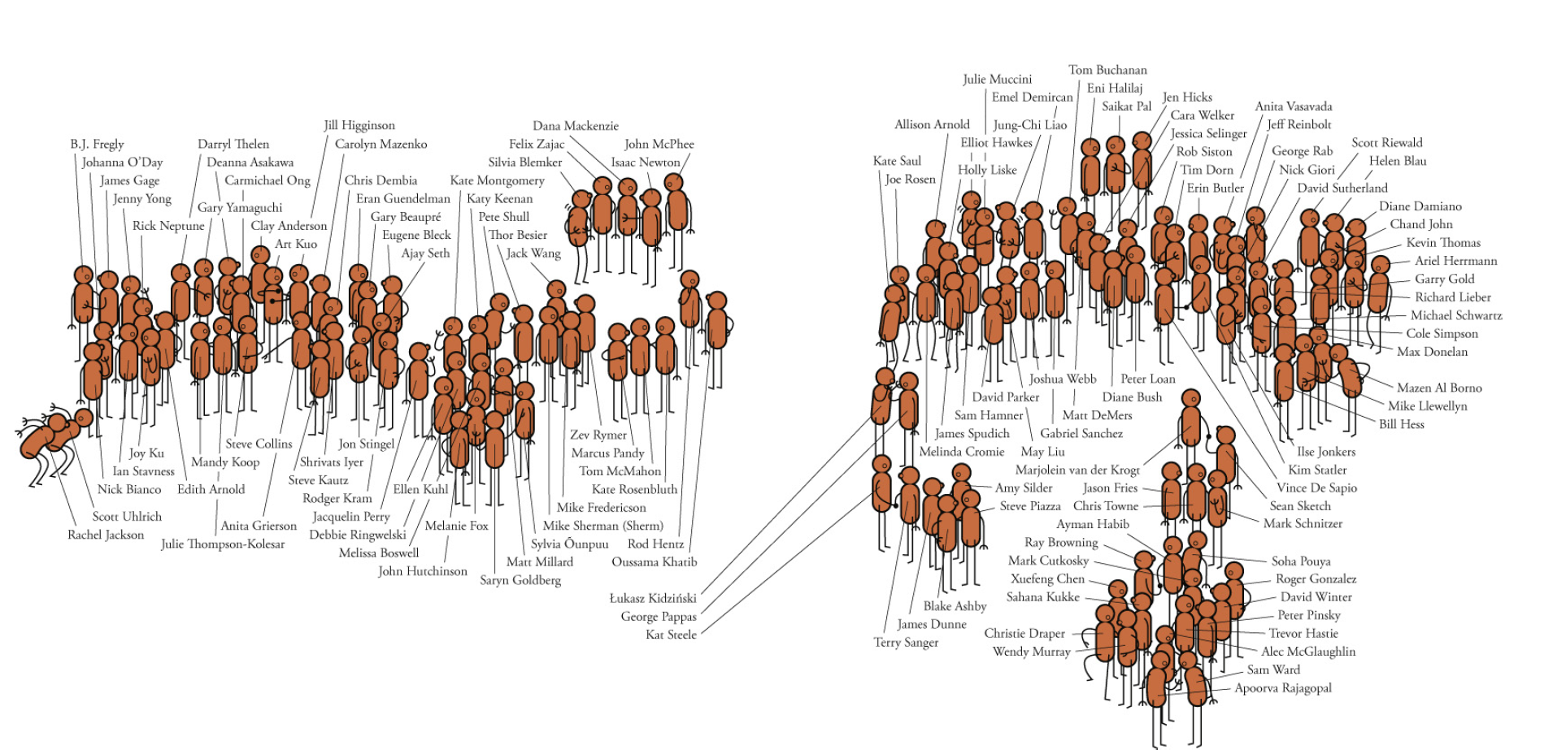

Slide 10
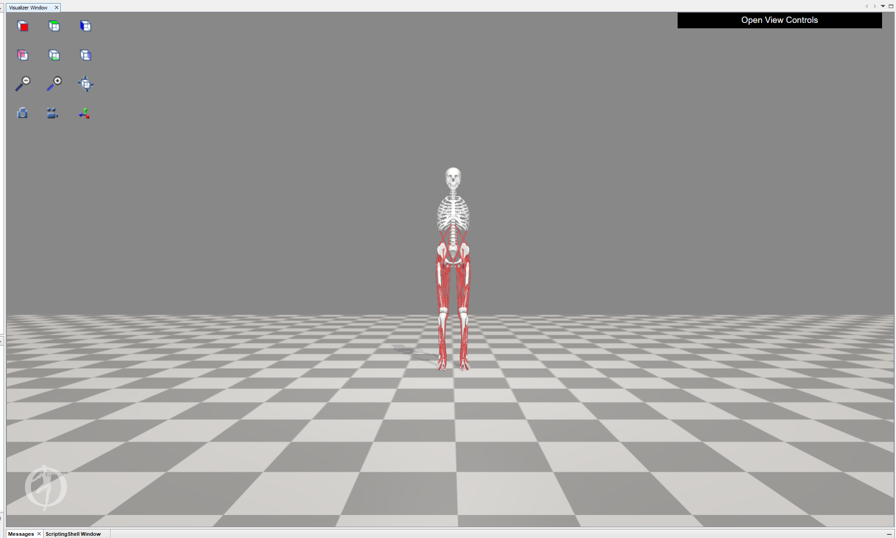

Slide 11
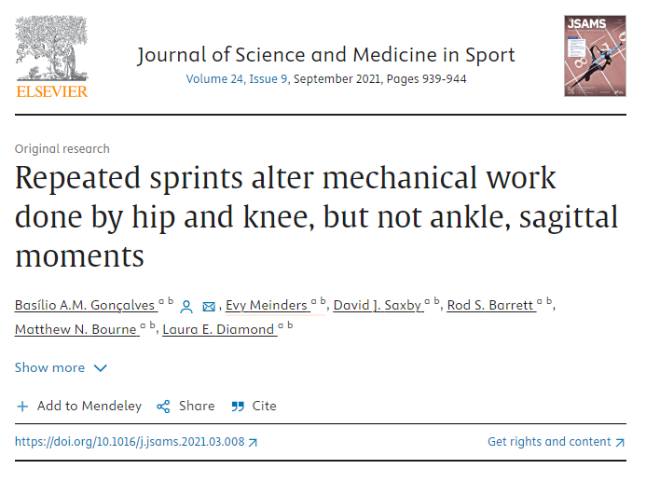
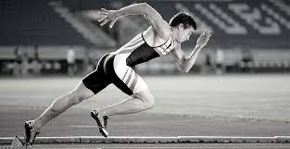
How has it been used?

Slide 12
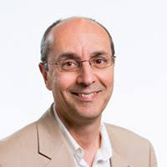
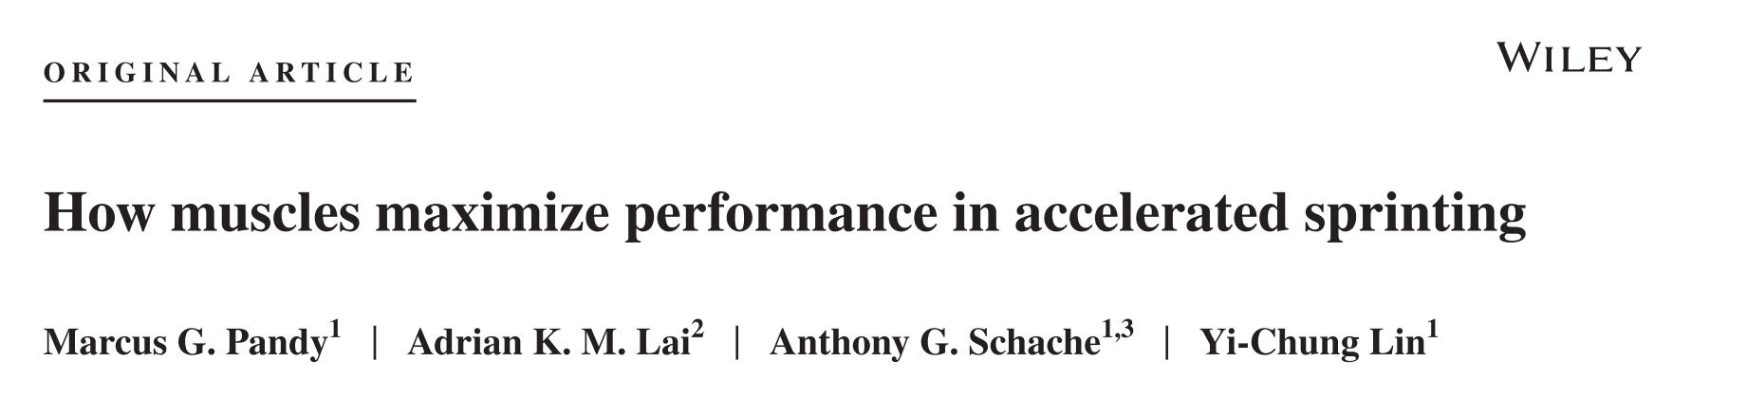
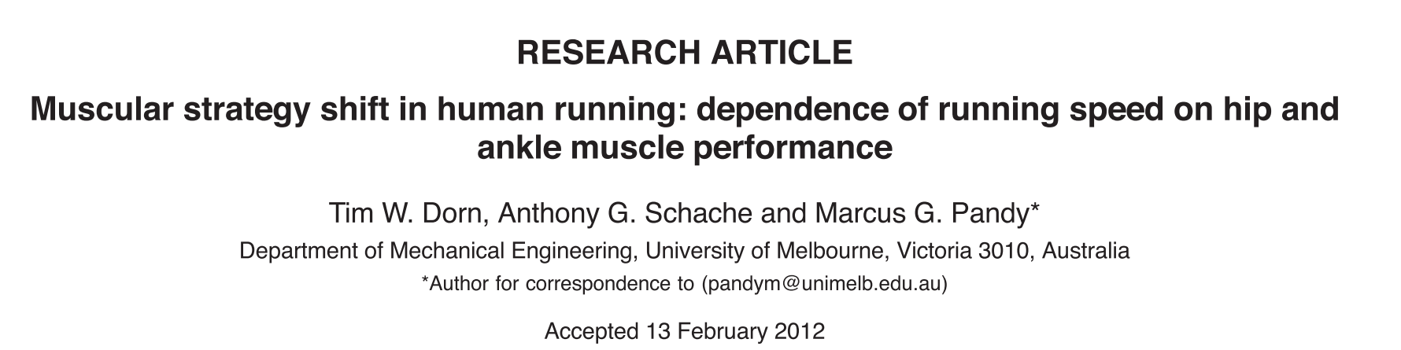
How has it been used?

Slide 13
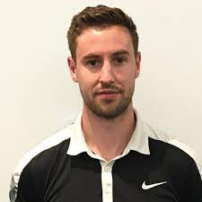
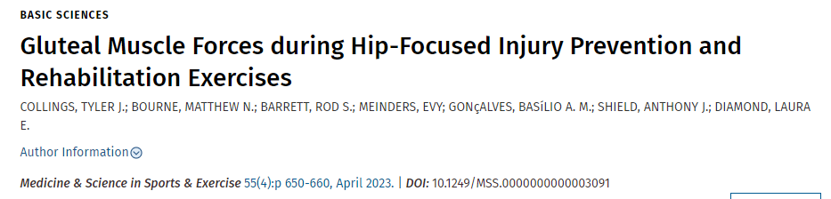
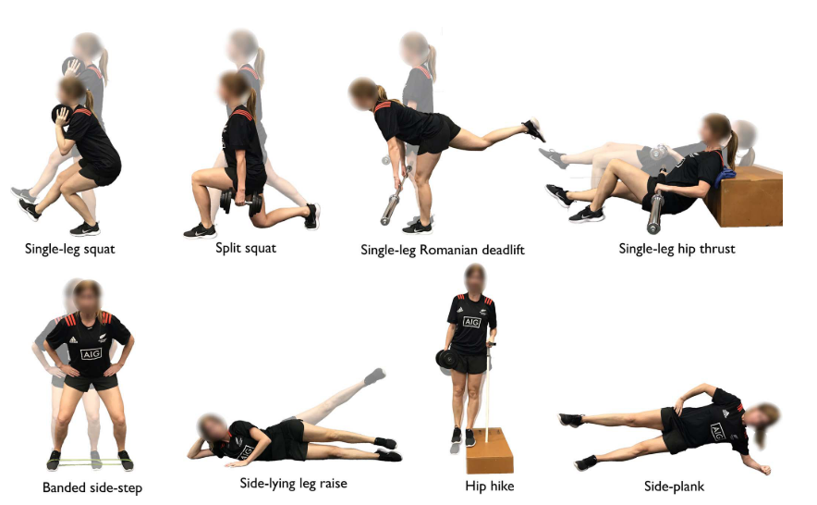
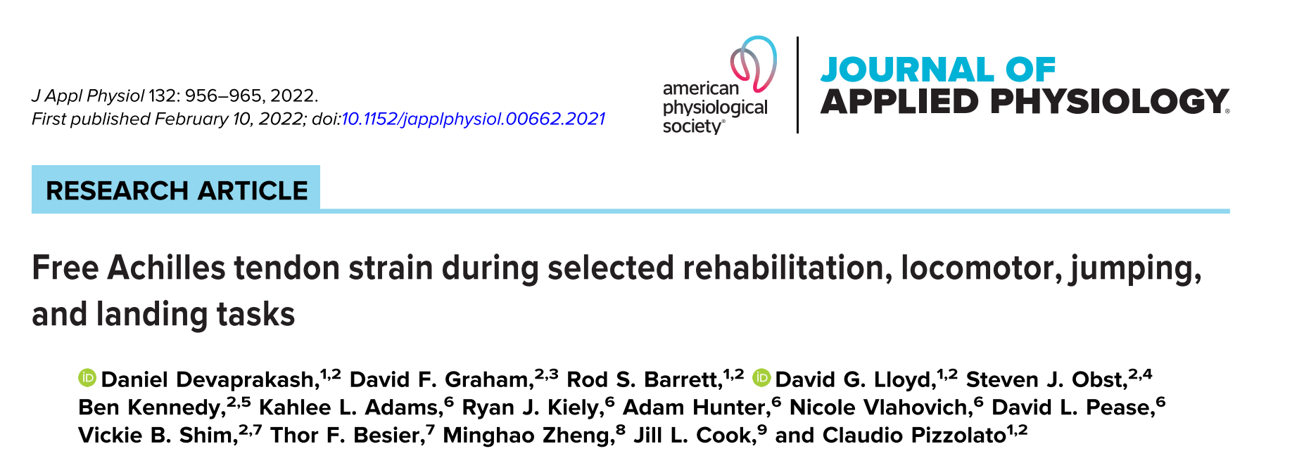
How has it been used?

Slide 14
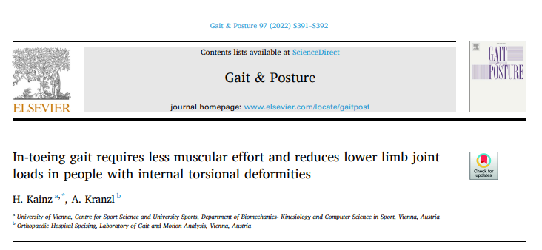
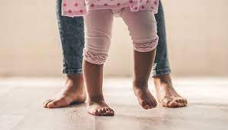
How has it been used?

Slide 15

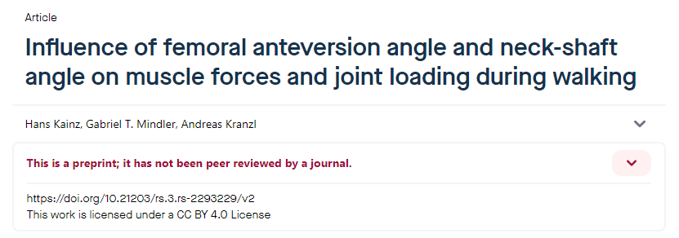
How has it been used?

Slide 16
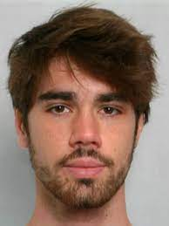
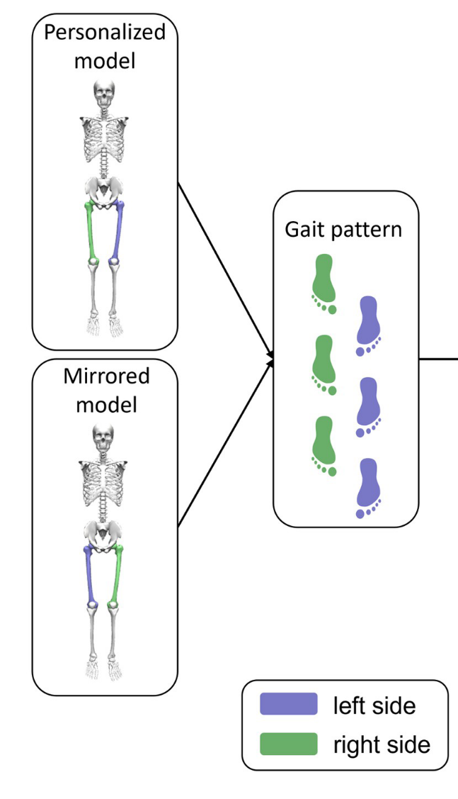
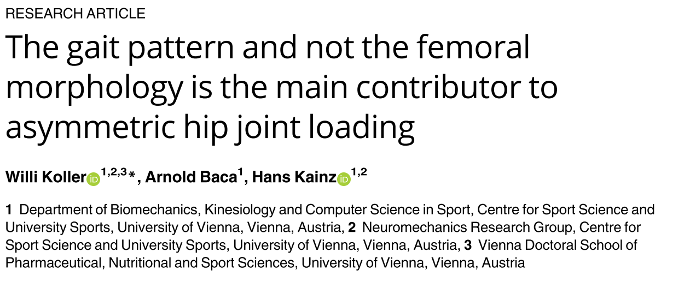
How has it been used?
Notes:
https://journals.plos.org/plosone/article?id=10.1371/journal.pone.0291789

Slide 17
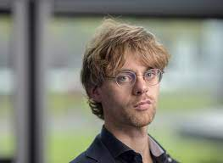

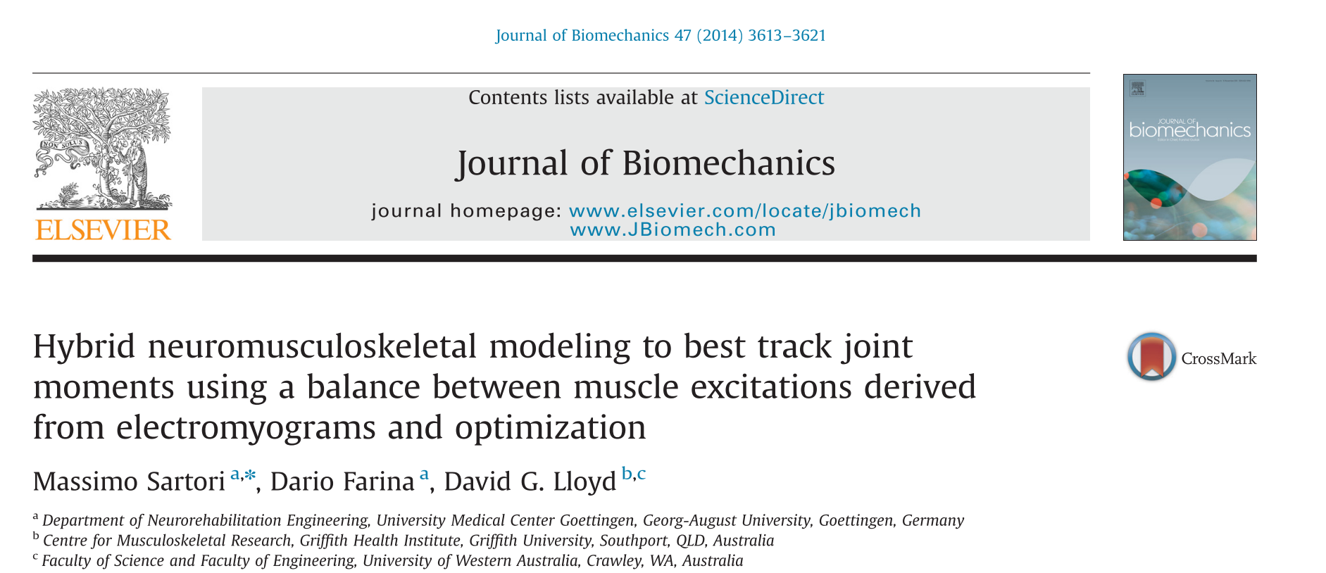
How has it been used?
Notes:
10.1016/j.jbiomech.2014.10.009

Slide 18
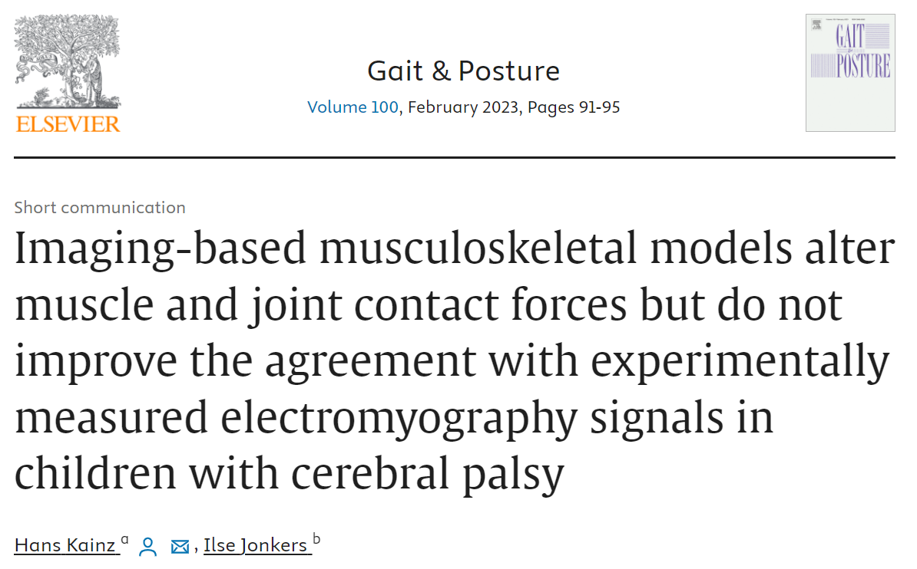
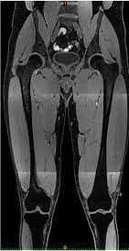
How has it been used?
Notes:
https://www.sciencedirect.com/science/article/abs/pii/S0966636222006567

Slide 19


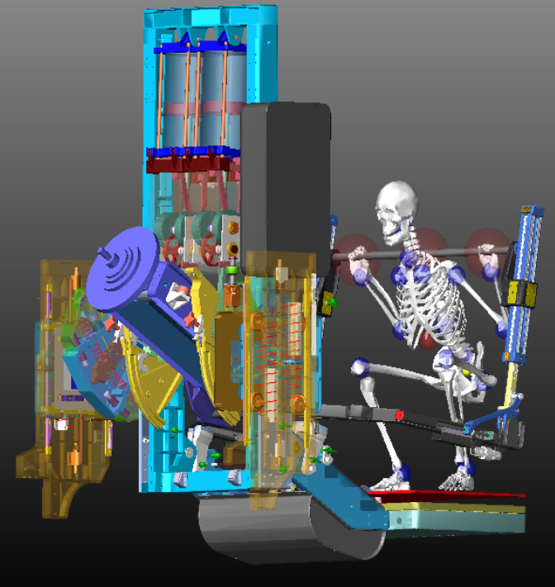
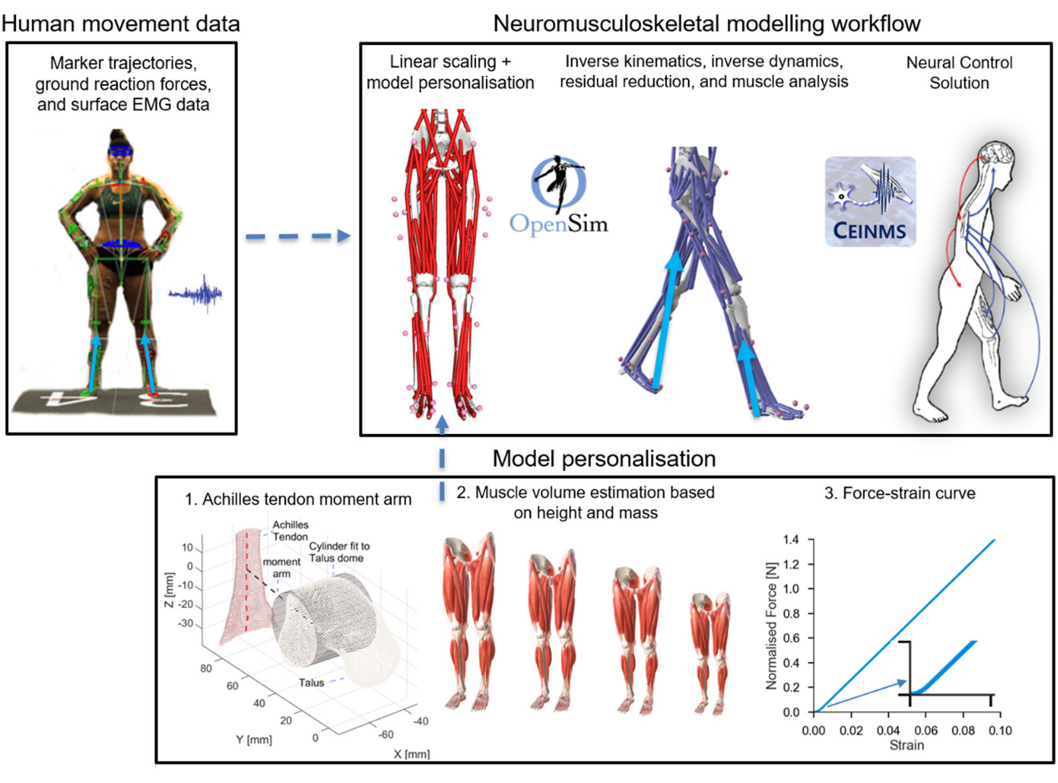
How has it been used?
Digital astronaut
Digital athlete
Notes:
https://www.nasa.gov/general/digital-astronaut-simulation-tool/
10.1152/japplphysiol.00662.2021

Slide 20
Modeling in opensim
Introduction to rigid body and muscle-tendon modelling;
The inverse problem
Model components
Input files
Available tools

Slide 21
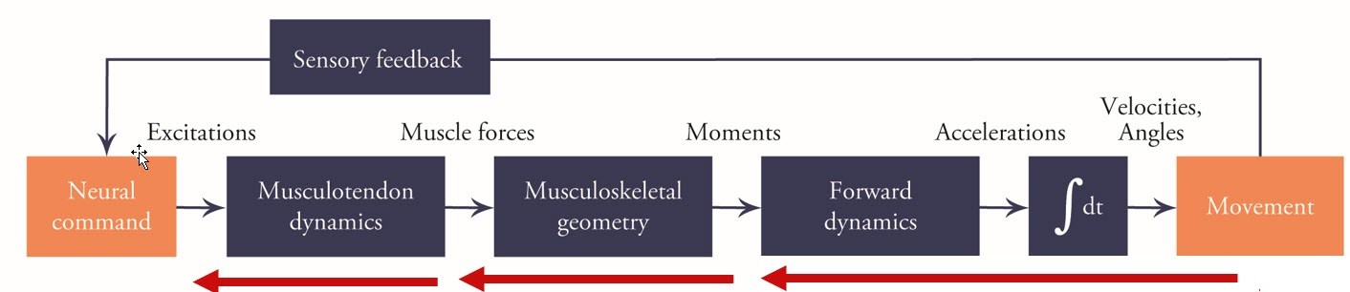
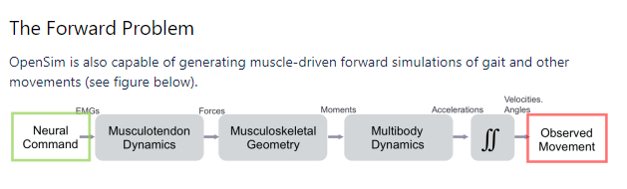
Inverse vs forward simulations
Introduction to rigid body and muscle-tendon modelling;

Slide 22
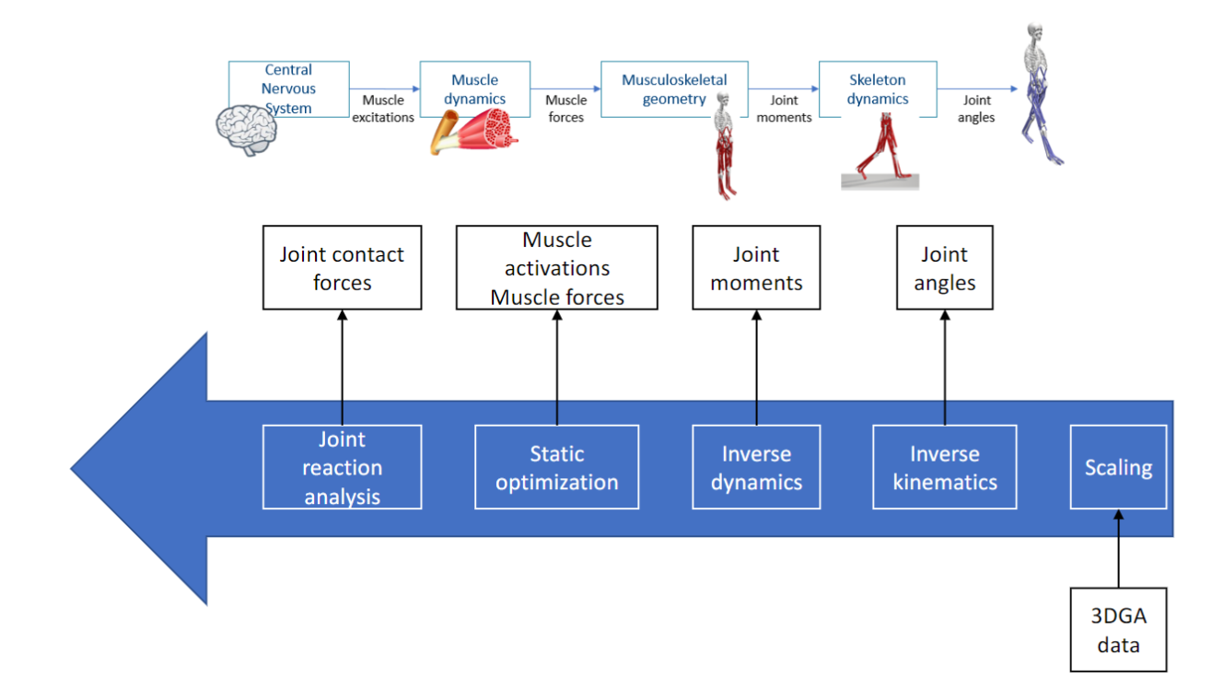
Inverse approach
Introduction to rigid body and muscle-tendon modelling;

Slide 23
What is a musculoskeletal model?
Introduction to rigid body and muscle-tendon modelling;
Rigid bodies
Connected by joints
Restricted by constrains
Actuated by muscles-tendon units
Informed by experimental data

Slide 24

Time to practice (use the folder “Hello_world_of_simulations”)
Introduction to rigid body and muscle-tendon modelling;
https://github.com/basgoncalves/BIP_OpenSim_Hungarian_USports

Slide 25
Questions
Introduction to rigid body and muscle-tendon modelling;
What are the components of a model?
How can a model be edited? (GUI, text editor, scripting)
How many bodies does this model have?
How many muscles does this model have in each leg?
What is the maximum isometric force of recfem?
How many DOF do the hip and knee joint have?
How heavy is the tibia segment?
Load experimental markers. Why are the markers doing a moon walk?
Load experimental GRF. Why are the forces not below the feet markers?

Slide 26
File types
Introduction to rigid body and muscle-tendon modelling;
.c3d - exported by most Gait Analysis laboratories
.trc – markers
.mot – motion files
.sto – storage files (results from analysis)
.xml – setup files
.osim – opensim models

Slide 27
Time to practice (practice plotting and explore files)
Introduction to rigid body and muscle-tendon modelling;
https://github.com/basgoncalves/BIP_OpenSim_Hungarian_USports

Slide 28
Questions
Introduction to rigid body and muscle-tendon modelling;
What is the maximum moment arm of psoas during hip_flexion_r?
Why are moment arms negative?
Plot the mtu length of the psoas_r during hip_flexion_r. Explain the figure.
Plot mtu length of lat_gas_r and bflh_r during hip flexion. Why are they so different?
Plot active, passive, and total-fiber force.

Slide 29
Break (10-15 min)
Introduction to rigid body and muscle-tendon modelling;

Slide 30
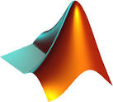

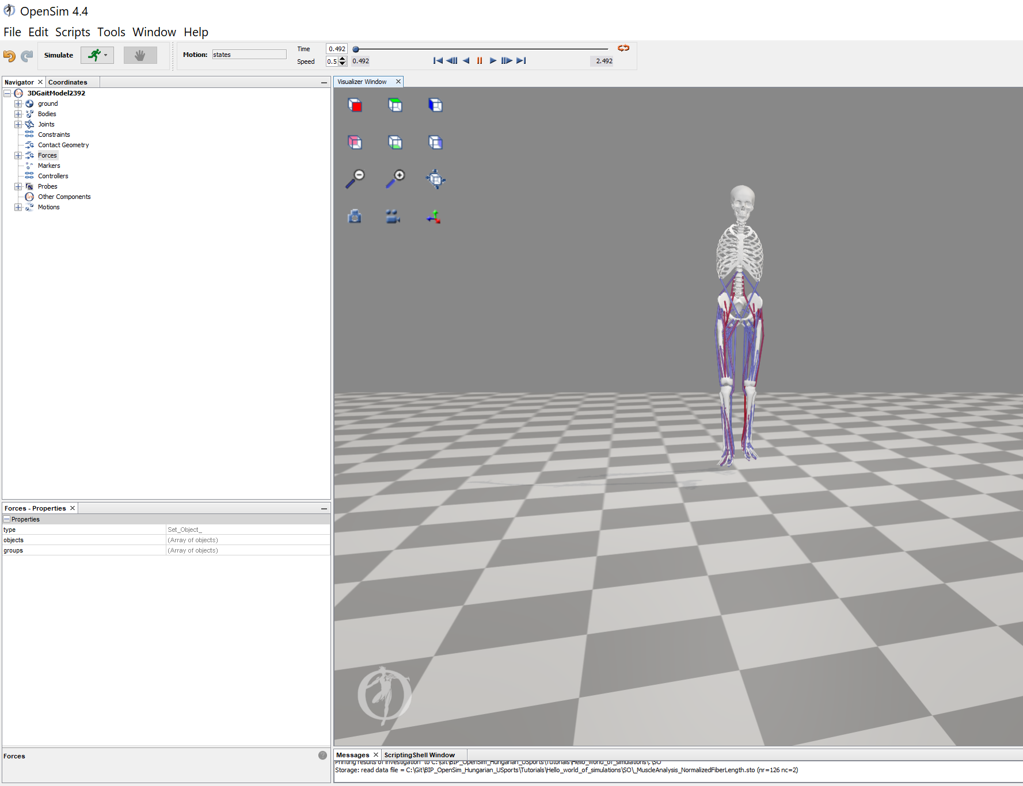
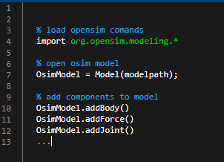
GUI vs CMD
Introduction to rigid body and muscle-tendon modelling;
C:\Users\Biomech\Documents\OpenSim\4.4\Code
https://simtk.org/api_docs/opensim/api_docs/

Slide 31
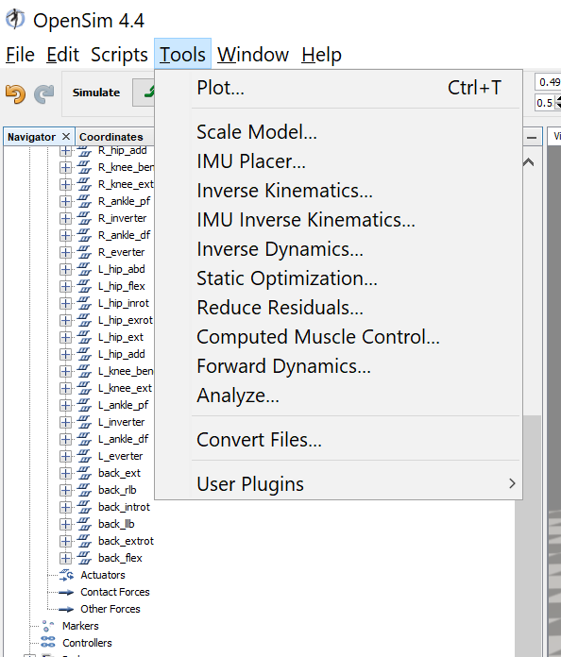
Run your first simulations

Slide 32
Time to practice (perform all analysis and plot results)
Introduction to rigid body and muscle-tendon modelling;
https://github.com/basgoncalves/BIP_OpenSim_Hungarian_USports

Slide 33
Questions
Introduction to rigid body and muscle-tendon modelling;
- What are the range of marker errors during the inverse kinematics step?
What are the peak hip, knee, and ankle angles?
What are the peak sagittal joint moments hip, knee, and ankle?
What are the lat_gas and rect_fem peak forces and activation?
What are the mtu lengths for bflh_r and soleus_r.
What are the maximum reserves moments hip_flexion_r, hip_adduction_r, hip_rotation_r, knee_angle_r, ankle_angle_r
How is the peak vertical component of hip contact loads, relative to participants body weight?

Slide 34
External biomechanics
Model personalization, Estimation of joint angles and external joint moments
Scaling
Inverse kinematics
Inverse dynamics
Residual reduction analysis
Muscle analysis

Slide 35
Time to practice (Sprinting)
Introduction to rigid body and muscle-tendon modelling;
https://github.com/basgoncalves/BIP_OpenSim_Hungarian_USports

Slide 36
Questions
Introduction to rigid body and muscle-tendon modelling;
What are the scaling factors of femur_r, tibia_r, and calcn_r.
How is the femur being scaled?
What is the weight of the “C7” marker?
Change the weight

Slide 37
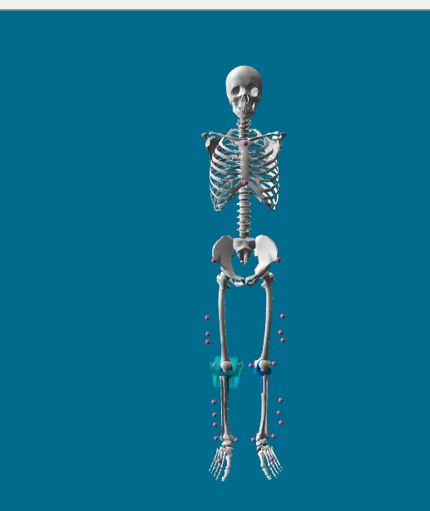
Scaling problems
Model personalization, Estimation of joint angles and external joint moments
Marker position
Marker weights
Check marker errors

Slide 38
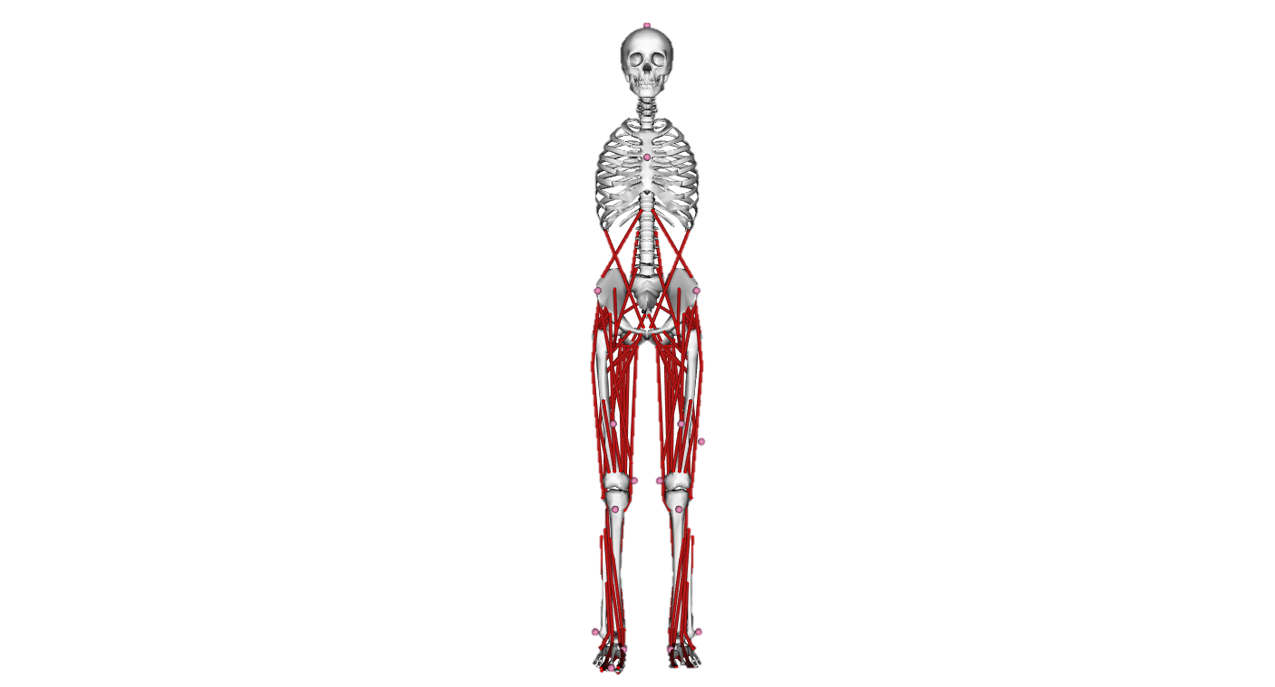


Why scaling?
Generic model

Slide 39
Why scaling?
Generic model

Slide 40
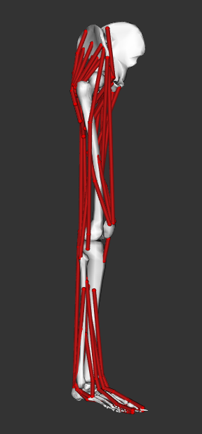
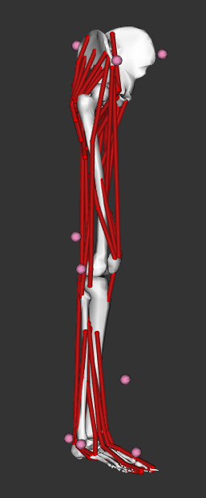

Scaling
Model + model markers
Experimental markers
Generic model

Slide 41


Definition of scale factors
Measurement-based scaling
Manual scaling
specified by the user based on some predetermined measure
e.g. anthropometric measurements
Generic model
Scaled model
Experimental markers
Model markers

Slide 42

Adjust model markers
adjusts the model markers to match the experimental markers at the static pose
Experimental markers
Model markers

Slide 43

Scaled model
Experimental markers
Model markers

Slide 44

Hints
Scaling can have a big impact on your simulation results
Use joint centers for scaling in participants with movement disorders

Slide 45


Direct Kinematics (DK)
Markers are rigidly attached to bones
Davis, 1988
Kadaba et al., 1989
Kadaba et al., 1990
Notes:
In Direct Kinematics it is assumed that the markers are rigidly attached to the bones. That means that it is assumed that no movements occur between the surface markers and the underlying bones. However, we know that this is not the case. If a person moves, soft tissue artefacts due to the movement of body segments and muscle contractions, change the position of the surface markers relative to the underlying bones.
The blue circles in this figure represent surface markers. The green circles represent joint centres which are also known as virtual markers.
Let’s assume that there is a lot of soft tissue artefacts at the shank segment and see what happens.

Slide 46
Direct Kinematics (DK)
Markers are rigidly attached to bones
Davis, 1988
Kadaba et al., 1989
Kadaba et al., 1990
Notes:
That’s a lot more soft tissue artefacts than in reality occurs but I want to show you what happens to the underlying skeletal model.

Slide 47
Direct Kinematics (DK)
Markers are rigidly attached to bones
Bone can change length
Davis, 1988
Kadaba et al., 1989
Kadaba et al., 1990
Notes:
Either it changes the segment lengths, in this case the shank segment.

Slide 48
Direct Kinematics (DK)
Markers are rigidly attached to bones
Bone can change length
Davis, 1988
Kadaba et al., 1989
Kadaba et al., 1990
Notes:
Or

Slide 49
Direct Kinematics (DK)
Markers are rigidly attached to bones
Bone can change length
Joints can fly apart
Davis, 1988
Kadaba et al., 1989
Kadaba et al., 1990
Notes:
It changes the position of the segment. That means the joints can fly apart. Neither, the change in bone length nor the change of the relative position of the segment is physiological correct. That’s one of the biggest drawbacks of Direct Kinematic approaches.

Slide 50

MSK modeling
Static calibration trial
Scaling
Scaled anatomical model
Dynamic walking trials
Inverse Kinematics
Joint angles
Inverse Dynamics
Joint moments
Muscle moment arms
Muscle-tendon lengths
Muscle forces, etc
Musculoskeletal analyses
Delp et al., 2007

Slide 51
Inverse kinematics (IK)
Experimental markers
Model markers
Notes:
Let’s play the same game as before and assume we have a participant with a lot of soft tissue and the markers are moving relative to the underlying bone. On the first picture here we can see the perfect case. All the model markers perfectly match the experimental markers. That’s the reason why we only see the model markers on this figure. The experimental markers are underneath the red model markers.

Slide 52
Inverse kinematics (IK)
Experimental markers
Model markers
Notes:
Let’s assume the experimental markers of the shank segment are a lot more distal compared to the model markers of the shank. Same initial situation as we had before when we were looking at the Direct Kinematics approach.

Slide 53
Inverse kinematics (IK)
Markers are NOT rigidly attached to bones
Fixed bone length
Constrained joint movements
Experimental markers
Model markers
Notes:
Inverse Kinematics changes the pose of the model, without changing the segment lengths or allowing the joints to fly apart, to match the position of the experimental markers as good as possible.
Let’s summarize the Inverse Kinematics approach again:
It is NOT assumed that the markers are rigidly attached to the bones but we have a rigid generic model, which does not allow changes in bone lengths after scaling. Furthermore, joint movements are constrained which prevents un-physiological joint movements.

Slide 54
Time to practice (inverse kinematics with different settings)
Introduction to rigid body and muscle-tendon modelling;
https://github.com/basgoncalves/BIP_OpenSim_Hungarian_USports

Slide 55
Questions
Introduction to rigid body and muscle-tendon modelling;
How do marker weights change scale factors?
What are, approximately, total, RMS, and maximum marker errors, after inverse kinematics?
Plot hip, knee, and ankle angles
What is the peak hip flexion angle during sprinting?
What is the peak knee flexion angle during sprinting?
What is the peak ankle plantarflexion angle during sprinting?
How can you increase the trust on your results?

Slide 56

Torque (τ)/Moment (M)
Introduction to rigid body and muscle-tendon modelling;
The tendency of a load to produce a rotation (not a translation!)
τ or M is the cross product of the
Applied force (F)
Moment arm (r): shortest distance between the line of force and the axis of rotation
M = F × r

Slide 57

Torque (τ)/Moment (M)
Introduction to rigid body and muscle-tendon modelling;

Slide 58
Time to practice (inverse dynamics)
Introduction to rigid body and muscle-tendon modelling;
https://github.com/basgoncalves/BIP_OpenSim_Hungarian_USports

Slide 59
Questions
Introduction to rigid body and muscle-tendon modelling;
How much is the peak grf relative to participant bodyweight?
What are the peak plantar flexion moment?
Why is the left ankle moment so much smaller compared with right?

Slide 60
Questions
Introduction to rigid body and muscle-tendon modelling;
What are the peak plantar flexion moment?
Why is the left ankle moment so much smaller compared with right?

Slide 61

Set-up files matter
Introduction to rigid body and muscle-tendon modelling;

Slide 62
Questions
Introduction to rigid body and muscle-tendon modelling;
What are the peak plantar flexion moment?
Why is the left ankle moment so much smaller compared with right?

Slide 63

Introduction to rigid body and muscle-tendon modelling;

Slide 64




Residual reduction analysis
Introduction to rigid body and muscle-tendon modelling;

Slide 65


Inverse dynamics leads to residuals forces / moments
Introduction to rigid body and muscle-tendon modelling;

Slide 66

RRA tool minimizes these residuals
Introduction to rigid body and muscle-tendon modelling;

Slide 67

Introduction to rigid body and muscle-tendon modelling;

Slide 68




Residual reduction analysis
Introduction to rigid body and muscle-tendon modelling;
Estimated joint kinematics
Adjusted joint kinematics
Estimated joint moments
Adjusted joint moments
Adjusted model

Slide 69


Constrains for force and kinematic adjustments
Introduction to rigid body and muscle-tendon modelling;
Joints of interest
(lower body)
Joint actuators
(hip, knee, ankle, lumbar…)
Joints not so relevant
(lumbar and arms)
Pelvis actuators

Slide 70
Questions
Introduction to rigid body and muscle-tendon modelling;
What is a residual moment?
What are the setup files needed to run the RRA tool?

Slide 71
Time to practice (residual reduction analysis)
Introduction to rigid body and muscle-tendon modelling;
https://github.com/basgoncalves/BIP_OpenSim_Hungarian_USports

Slide 72
Questions
Introduction to rigid body and muscle-tendon modelling;
Plot the trunk, hip, knee, and ankle kinematics before and after RRA (ik.mot and .\RRA\_Kinematics_q.sto)
What changed more hip flexion or trunk extension angles?
How did the residual moments change after RRA?
Are the residual moments acceptable?

Slide 73


How to access my results
Introduction to rigid body and muscle-tendon modelling;
https://simtk-confluence.stanford.edu:8443/display/OpenSim/Getting+Started+with+RRA
Notes:
https://simtk-confluence.stanford.edu:8443/display/OpenSim/Getting+Started+with+RRA

Slide 74
Questions
Introduction to rigid body and muscle-tendon modelling;
How did the maximum residual moments change after RRA?
Are the residual moments acceptable?

Slide 75

Muscle forces in OpenSim
Estimation of muscle and joint contact forces
Garbage in garbage out
Check the inputs files
Check muscle moment arm
Check setup files

Slide 76
Time to practice (plot moment arms)
Introduction to rigid body and muscle-tendon modelling;
https://github.com/basgoncalves/BIP_OpenSim_Hungarian_USports

Slide 77

Introduction to rigid body and muscle-tendon modelling;

Slide 78


Muscle are represented as a single fibre
Thelen, J. Biomech. Eng., 125, 1, 70–77, (2003)
Notes:
https://simtk-confluence.stanford.edu:8443/display/OpenSim/Muscle+Model+Theory+and+Publications
https://simtk-confluence.stanford.edu:8443/display/OpenSim/Thelen+2003+Muscle+Model

Slide 79

Model assumptions
Muscles = massless, frictionless, extensible strings
All fibres are parallel
Fixed muscle “height” or thickness
Force produced = scaled version of the force developed by a single fibre
Muscle force depends on:
Activation
Length
Velocity
Millard et al., J. Biomech. Eng., 135, 2, (2013)

Slide 80



The main muscle parameters
C

Slide 81









Static optimization
Determines the “best” set of muscle forces that
Produce net joint moments at a discrete time
Do not violate muscle force limits
Optimize a performance criterion
Gastrocnemius
Tibialis anterior
Soleus
Extensor digitorum
Tibialis posterior
Notes:
https://simtk-confluence.stanford.edu:8443/display/OpenSim/How+Static+Optimization+Works

Slide 82
The Muscle Force Distribution Problem
number of flexors
number of extensors
1 equation with n_{f} + n_{e} unknowns
moment arm
flexion moment
extension moment
Gastrocnemius
Tibialis anterior
Ankle example
Soleus
Extensor digitorum
Tibialis posterior
How can we solve this?
Notes:
https://simtk-confluence.stanford.edu:8443/display/OpenSim/How+Static+Optimization+Works

Slide 83
Static optimization formulation
Example for performance criteria
Muscle force
Metabolic energy
(Muscle stress)³ ~
(Muscle activation)²
Notes:
https://simtk-confluence.stanford.edu:8443/display/OpenSim/How+Static+Optimization+Works

Slide 84
Time to practice (static optimisation)
Introduction to rigid body and muscle-tendon modelling;
https://github.com/basgoncalves/BIP_OpenSim_Hungarian_USports

Slide 85
Questions
Introduction to rigid body and muscle-tendon modelling;
What are the main 3 factors affecting muscle forces
What is the main difference between the actuator.xml files from RRA and SO?

Slide 86
Time to practice (static optimisation – walking data)
Introduction to rigid body and muscle-tendon modelling;
https://github.com/basgoncalves/BIP_OpenSim_Hungarian_USports

Slide 87
Questions
Introduction to rigid body and muscle-tendon modelling;
What are peak force of biceps femoris and soleus muscles?
How do the muscle activations look?

Slide 88




Joint reaction forces
Design Biomedical Devices
Predict Tissue Stress
Study degradation
Argenson et al, 2005
Draper et al. 2006
USC2000, 2009, http://www.flickr.com/photos/usc2000/3189533413/
Notes:
88
Joint Reaction analysis calculates joint loads in a post processing step.

Slide 89
Analyze tool to investigating a simulation
OpenSim Model
Analysis
Analysis
Analysis
Analysis
Fiber/Tendon
Lengths
Moment
Arms
Body
Kinematics
Joint
Reactions
Notes:
An analysis probes and reports data from the model during a simulation.

Slide 90








Steele et al. 2012
Notes:
Joint forces and moments transferred between consecutive bodies as a result of all loads acting on the model:
Resultant forces and moments the joint structure caries in response to all motions and forces in the model, including muscles, motors, and all other actuators

Slide 91




Steele et al. 2012
Notes:
The JointReaction analysis calculates the resultant forces and moments that the joint carries to prevent movement that cannot be produced

Slide 92
Steele et al. 2012

Slide 93
Time to practice (joint reaction analyse)
Introduction to rigid body and muscle-tendon modelling;
https://github.com/basgoncalves/BIP_OpenSim_Hungarian_USports

Slide 94




Validation
Compare results to in vivo measured loads
Compare results to previous publications
Giarmatzi et al. 2015
Example from Bühler et al. 2021
https://orthoload.com/
Example from Kainz et al. 2020
Notes:
Go conceptual

Slide 95
Questions
Introduction to rigid body and muscle-tendon modelling;
What are the input files to calculate joint reaction loads?
What should be the apply_on_bodies and express_in_frame inputs?
What are the peak hip and knee joint forces in the 3 different axis?

Slide 96
Hands on examples
Simulate the effects of musculoskeletal alterations on muscle and joint loads
Bone deformities (45 min)
Compare muscle forces before and after maximal repeated sprints (45 min)
Simulation and Analysis of a Tendon Transfer Surgery (45 min)
https://github.com/basgoncalves/BIP_OpenSim_Hungarian_USports

Slide 97

OpenSim add-ons and the future of musculoskeletal modelling
Summary and future directions
Notes:
https://simtk.org/projects/nmsm/

Slide 98















Data collection
Data processing
External biomechanics¹
Musculoskeletal modelling²
Marker data
Maker labelling
Linear anthropometric scaling
MTU calibration
Optimal fibre length
Maximal isometric strength
Tendon slack length
Activation coefficients
Muscle and joint contact force estimation
Analog data
Data filtering
Inverse kinematics
Inverse dynamics
Notes:
Participants will be invited to attend one data collection session in the biomechanics laboratory of Griffith university. A physical examination will be performed before data collection which will be followed by the participant set-up with the EMG and motion caption marker placement.
Biomechanics and neuromuscular assessment tasks designed to place the hip in impingement positions followed by measurements of muscle strength based on the results from studies 1 and 2 will then be fperformed. after a fatigue protocol the same tests bill be performed to assess the effects of running induced fatigue
We already identified 10 asymptomatic FAI individuals from previous data collection that will ask to participate

Slide 99






Tools to convert your data
Summary and future directions
https://simtk.org/api_docs/opensim/api_docs/
https://simtk-confluence.stanford.edu:8443/display/OpenSim/Tools+for+Preparing+Motion+Data
https://addbiomechanics.org/
Bedo et al. 2021, BOPS: a Matlab toolbox to batch musculoskeletal data processing for OpenSim
https://github.com/WilliKoller/processC3D_GUI

Slide 100






Summary and future directions
Arkel et al. 2013
Pizzolato et al. 2015
Modenese et al. 2016
Geijtenbeek 2019
Dembia et al. 2020
Hammond et al. 2023
Notes:
https://simtk.org/projects/nmsm/

Slide 101


Veerkamp et al., J. Biomech., 125, 110589, (2021)

Slide 102


Data collection
Estimated excitations for muscles without experimental EMG
Static trial
Marker coordinates
Linear scaled model¹
Muscle-tendon parameter optimization²
Running and walking trials
Inverse kinematics
Muscle analysis
Marker coordinates
Joint angles
MTU kinematics
MTU calibration³
Muscle activations
Inverse dynamics
Muscle moment arms
MTU lengths
Joint moments
Optimal fibre length
Maximal isometric strength
Tendon slack length
Activation coefficients
Ground reaction forces
Joint moments
MTU forces
EMG
(12 muscles)
Linear envelope
Joint reaction analysis
Normalised muscle activity
Maximum isometric voluntary contractions
Hip contact forces
EMG
(12 muscles)
Maximum muscle activity
Notes:
Participants will be invited to attend one data collection session in the biomechanics laboratory of Griffith university. A physical examination will be performed before data collection which will be followed by the participant set-up with the EMG and motion caption marker placement.
Biomechanics and neuromuscular assessment tasks designed to place the hip in impingement positions followed by measurements of muscle strength based on the results from studies 1 and 2 will then be fperformed. after a fatigue protocol the same tests bill be performed to assess the effects of running induced fatigue
We already identified 10 asymptomatic FAI individuals from previous data collection that will ask to participate

Slide 103


Hoang et al., J. Biomech., 83, 134–142, (2019)

Slide 104

Hoang et al., J. Biomech., 83, 134–142, (2019)

Slide 105
Future of musculoskeletal modelling
Summary and future directions
Personalised modelling
Real time tissue loading
Predictive simulations
Surgical assistance
Lloyd, Sport. Biomech., 1–29, (2021)
De Groote and Falisse, Proc. R. Soc. B Biol. Sci., 288, 1946, (2021)
Notes:
https://royalsocietypublishing.org/doi/10.1098/rspb.2020.2432

Slide 106

Thank you!!
Summary and future directions
Notes:
https://royalsocietypublishing.org/doi/10.1098/rspb.2020.2432

